Slide 1
3.20 Mock

Slide 2
What is Stream API and what are some of its functions?

Slide 3
What is functional interface?

Slide 4
What is the difference between filer() and map()

Slide 5
What is method reference?

Slide 6
Optional

Slide 7
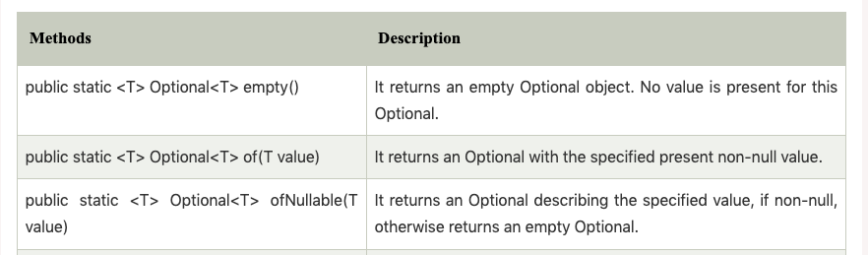
Three ways we can create optional objects

Slide 8
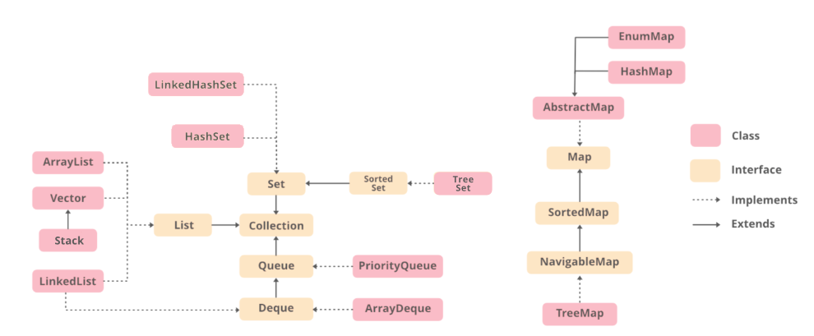

Slide 9
IdentityHashMap only compares key references
WeakHashMap will make sure entries will be handled by gc once key is discarded.
LinkedHashMap will maintain the insertion order of its entries

Slide 10
Set
HashSet LinkedHashSet TreeSet
List
ArrayList LinkedList Vector stack
Map
HashMap LinkedHashMap TreeMap HashTable ConcurrentHashMap WeakHashMap IdentityHashMap
Comparable vs Comparator
Cursor
Iterator ListIterator Enumerator

Slide 11
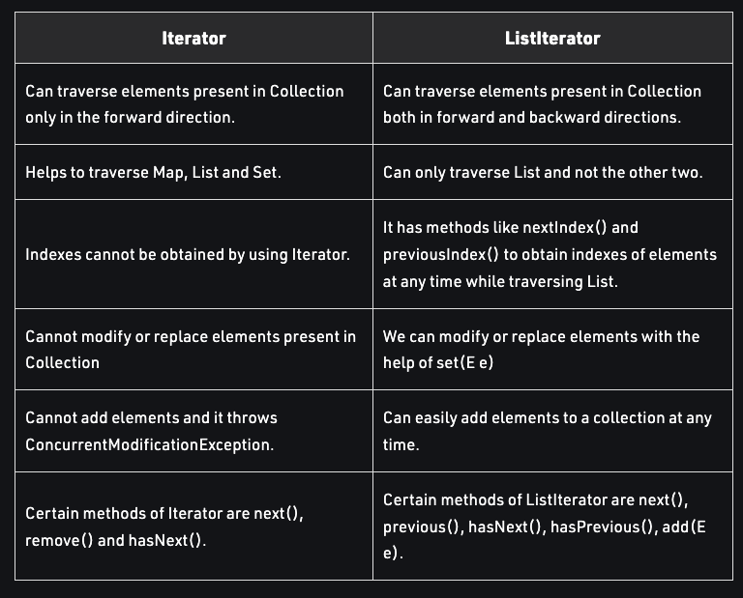
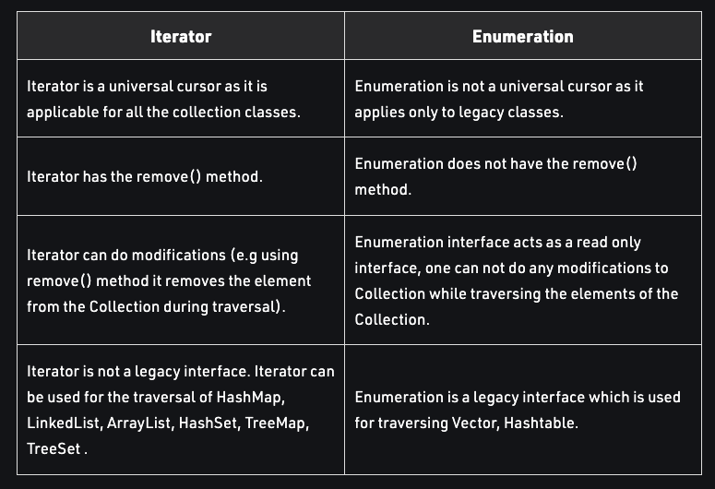
Iterator vs ListIterator vs Enumeration
3
4+3+2

